Slide 1
CENE 476 - Old Town Frame Company
Mitchell Tulk, Saud Al Saadoon, Ryan Wolff, Matt Rollins
December 7, 2018

Slide 2
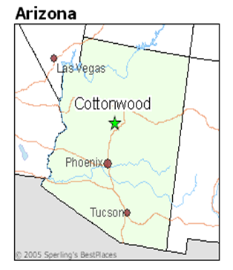
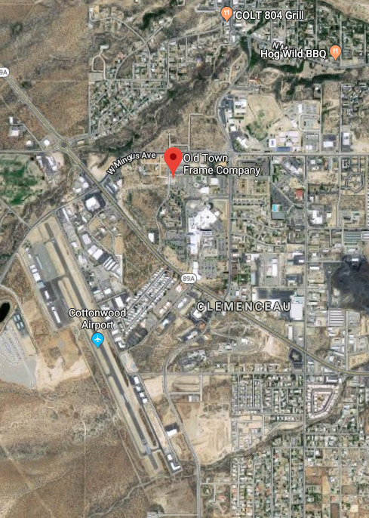
Aerial Map
Cottonwood is a city in Yavapai County, Arizona.
Figure 1: Cottonwood, AZ [1]
Figure 2: Location in Cottonwood [2]

Slide 3
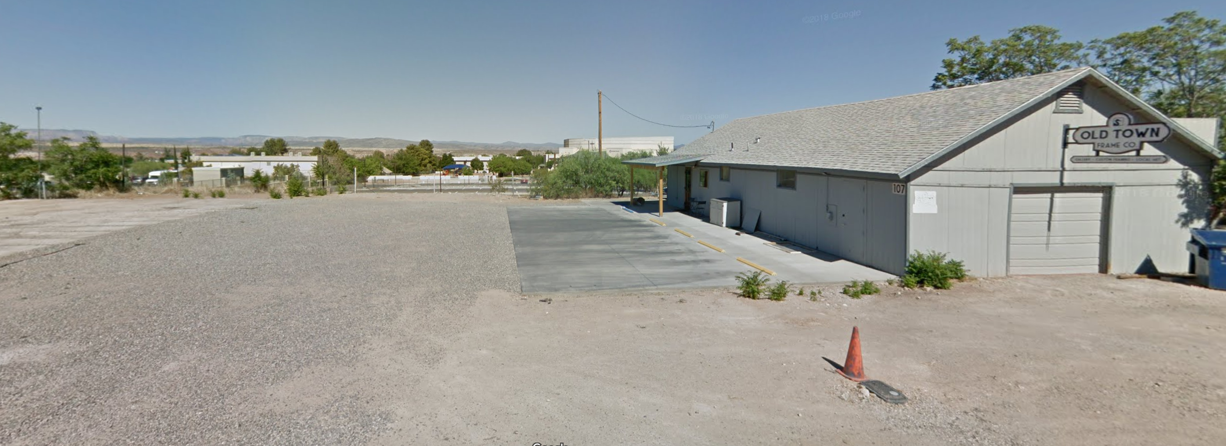
Local Site Map
This project is to complete a site redesign for Old Town Frame Company in Cottonwood, Arizona.
The project will involve survey field work,geotechnical analysis, grading design, parking lot design, and creation of construction plans.
Figure 3: Google street view of site [2]

Slide 4

Stakeholders
Old Town Frame Company
Located in Cottonwood, AZ
Owned by Client: Trevor Gottschalk
Address: 107 S Candy Ln, Cottonwood, AZ 86326
Phone Number: (928) 634-6311
Adjacent roadway is owned by Clemenceau Townsite, LLC.
Figure 4: Company Logo [2]

Slide 5
Project Scope
Task 1 : Due Diligence
Task 1.1: Existing Mapping
Task 1.2: Site Due Diligence
Task 2: Site Investigation
Task 2.1: Lot Sketch
Task 2.2: Field Investigation
Task 2.3: Land Survey
Task 2.4: Soil Sampling
Task 3: Geotechnical Analysis
Task 3.1: Moisture Content
Task 3.2: Sieve Analysis
Task 3.3: Hydrometer Test
Task 3.4: Consolidated Undrained Test
Task 3.5: Direct Shear Test
Task 3.6: Triaxial Compression Test
Task 3.7: Lab Testing Report

Slide 6
Project Scope Cont.
Task 4: Site Topo Map
Task 4.1: Data Processing
Task 4.2: Topographic Map
Task 4.3: Aerial Map
Task 5: Parking Lot Design
Task 5.1: Existing Drainage
Task 5.2: Parking Lot Layout
Task 5.3: Proposed Drainage Plan
Task 6: Construction Plans
Task 6.1: Create Border
Task 6.2: Cover
Task 6.3: Notes/ Details
Task 6.4: Site Layout
Task 6.5: Plan and Profile
Task 6.6: Cross Sections

Slide 7
Task 7: Project Management
Task 7.1: Meetings
Task 7.1.1: Technical Advisor
Task 7.1.2: Client
Task 7.1.3: Grading Instructor
Task 7.1.4: Lab Coordination
Task 7.2 Deliverables
Task 7.2.1: 30% Submittal
Task 7.2.2: 60% Submittal
Task 7.2.3: Final Report
Task 7.2.4: Website
Task 7.3: Travel Reports
Task 7.4: Engineers Opinion of Probable Cost

Slide 8
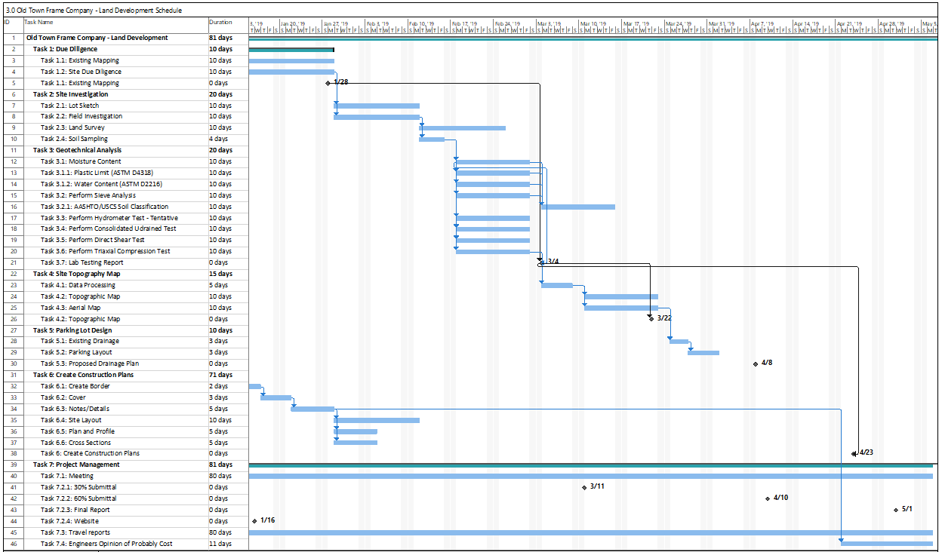


Schedule
fFigure 5: Project Schedule from Microsoft Project.

Slide 9
Milestones
01/16/2019: Project Website
01/28/2019: Existing Site Mapping
03/04/2019: Lab Testing Report
03/11/2019: 30% Submittal
03/22/2019: Existing Topo Map
04/01/2019: Parking Lot Design
04/08/2019: Proposed Drainage Plan
04/10/2019: 60% Submittal
04/23/2019: Construction Plans
05/01/2019: Final Submittal

Slide 10
Project Challenges and Limitations
Challenges:
Retaining wall analysis.
Project site boundaries are currently unknown.
Surrounding property easements are unknown.
Exclusions:
Pavement design
Professional survey stake

Slide 11
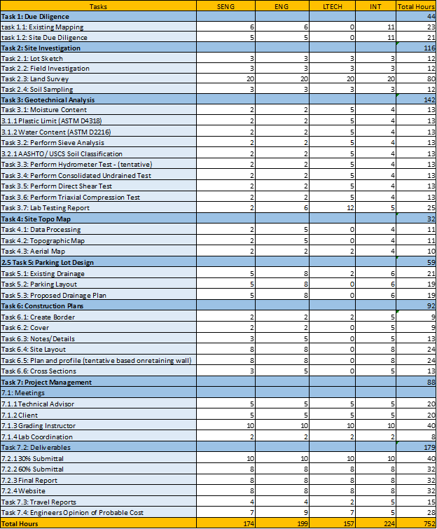
Staffing
Senior Engineer
10 years of experience
Registered P.E.
Engineer
4 Years of experience
Registered E.I.T
Lab Tech
5 years of experience
Intern
Entry level
Current student, or recent graduate
Figure 6. Staff Estimation Hours

Slide 12
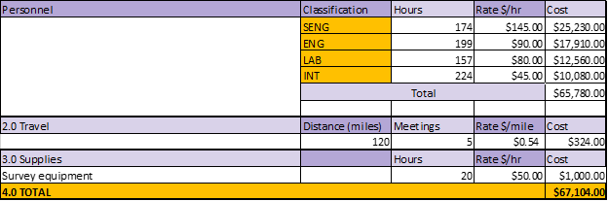
Cost
Figure 7. Engineer’s Estimated Cost of Engineering Services

Slide 13
References
[1] Cottonwood, AZ. https://www.bestplaces.net/city/arizona/cottonwood
[2] Google Maps. 2018.
[3] Old Town Frame Company. 2018. http://www.oldtownframecompany.com/

Slide 14
Questions

